Slide 1

Downtown Specific Plan
May 25, 2025

Slide 2

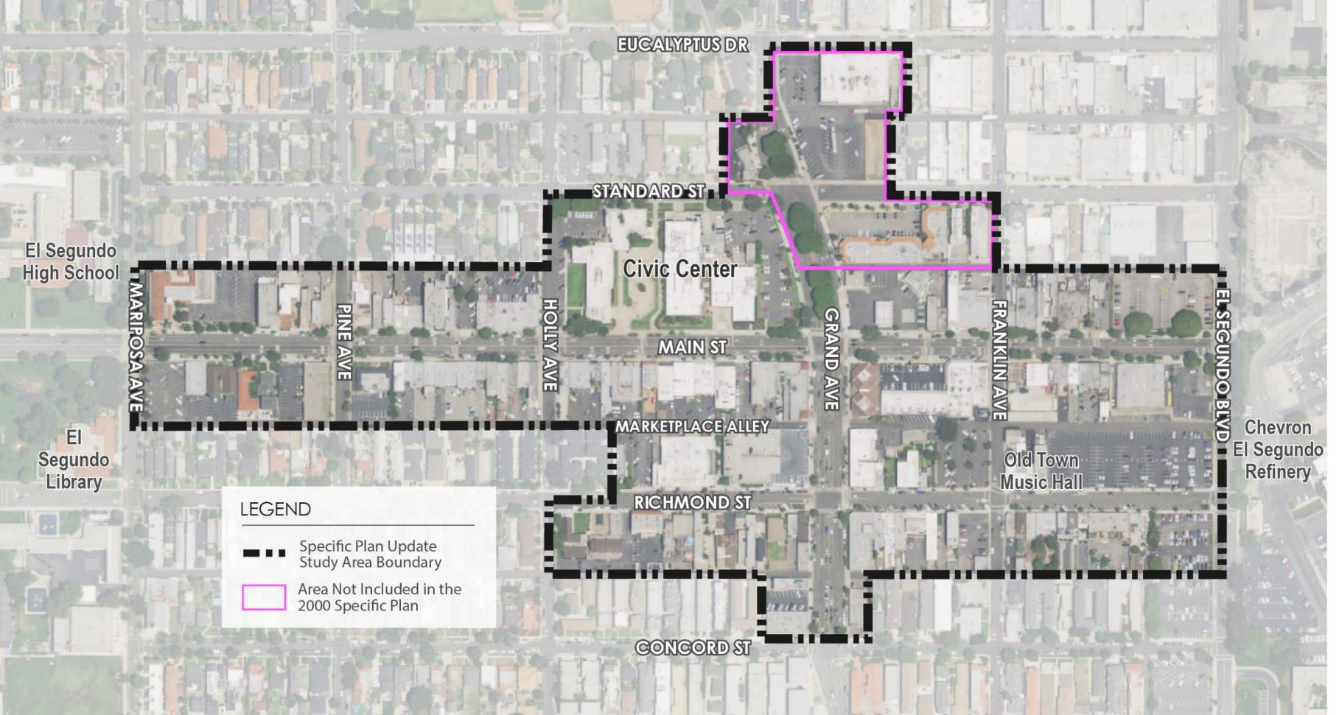
Specific Plan Update Boundary
Rite Aid
Chase Bank

Slide 3

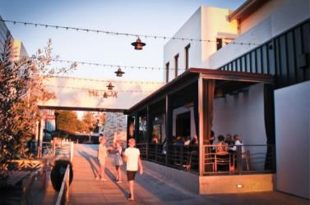
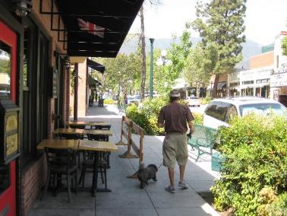
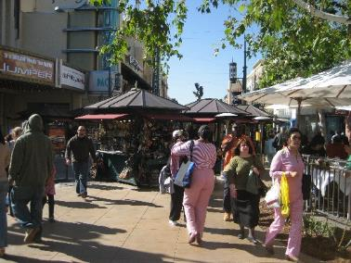
Agenda
Background and status
Specific Plan Contents
Highlights - Major changes
Questions, comments, discussion
Next steps
Notes:
Background: summary of work up to today
Specific Plan Contents – Summary of each chapter
Highlights – go over the major changes in the document, permitted uses, development standards, public improvements
Questions – Planning commission and public comments
Next steps- steps between today and public hearings/adoption

Slide 4
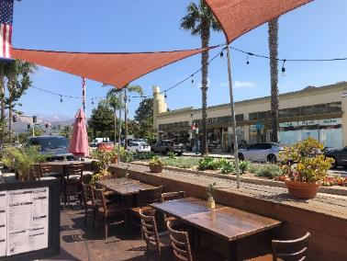
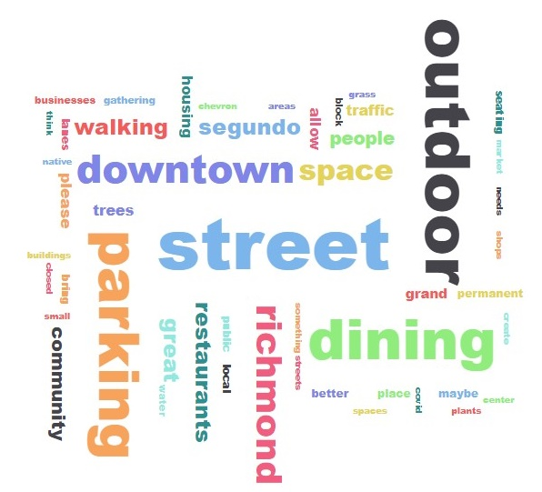
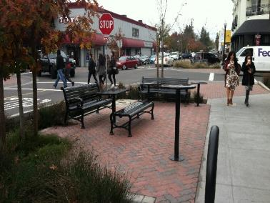
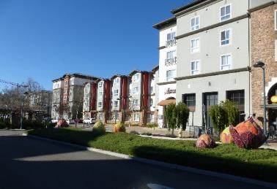
Background and status
  Project initiation in late 2021
  Existing conditions assessment
  Community outreach
  Design concepts development
  Environmental Review (EIR)
  Draft Specific Plan
Notes:
Existing conditions:
Studied existing documents
Real Estate Market Demand assessment
Traffic assessment (opportunities and constraints)
Parking assessment
Historic Resources assessment
Community outreach:
Two rounds of stakeholder interviews
Community survey (May-July 2022)
Community workshop (June 2022)
Design concept development (Fall 2022)
Presentation to Rotary club
Community workshop (November 2022)
CEQA:
The market demand, community feedback, design concepts, produced an overall project description and development build out projection so we could initiate the environmental review process
Drafted an initial study, released in January 2023, held a scoping meeting in February, and have continued to work on a draft DSP
Draft DSP made public last week and will be available for several weeks for the public to review and comment
Tonight’s meeting is intended to introduce/describe the draft document to the public

Slide 5
Specific Plan contents
  Introduction and Vision
  Private Realm – Land use and development standards
  Public Realm – Multimodal Mobility
  Public Realm – Placemaking and Beautification
  Infrastructure and Public Facilities
  Implementation
  Administration

Slide 6
Specific Plan contents
  1. Introduction and Vision
Downtown is the heart of El Segundo, and its vibrant energy will continue to provide an attractive and accessible destination for families of all ages and incomes to stay, play, and relax. The vision of this Specific Plan is to create an economically prosperous Downtown with a mix of uses and entertainment options and cohesive elements that tie the community together. The Specific Plan’s goal is to create a balance of uses within the Downtown to reach its optimal potential and will provide direction for streetscape beautification, outdoor gathering spaces, improved mobility, and other enhancements that will establish a unique and inviting environment that highlights its historical and cultural roots to enrich this community destination.
Notes:
Purpose is to replace the existing Specific Plan, establish a new or updated vision for the downtown and put in place the regulations and plans to realize that vision
Downtown is the heart of El Segundo, and it provides an attractive destination for all families to stay, play, and relax. Building from this starting point, the vision –based on our research and the input we received so far - is to create an economically prosperous Downtown with a mix of uses, entertainment options, and other elements that tie the community together. More specifically, the Specific Plan’s goal is to create a balance of uses to help Downtown reach its optimal potential and to provide direction for streetscape improvements, outdoor gathering spaces, mobility and other enhancements that will make the Downtown a unique and inviting environment that also highlights its historical and cultural roots.
The introduction and vision chapter of the Specific Plan elaborates more on this with some principles for private and public improvements.

Slide 7
Specific Plan contents
  2. Private Realm – Land use and development standards
Downtown Specific Plan District Map
Notes:
In the private realm, chapter the Plan regulates land uses and development standards, but it all starts with zoning. There are four distinct zones (list them)

Slide 8
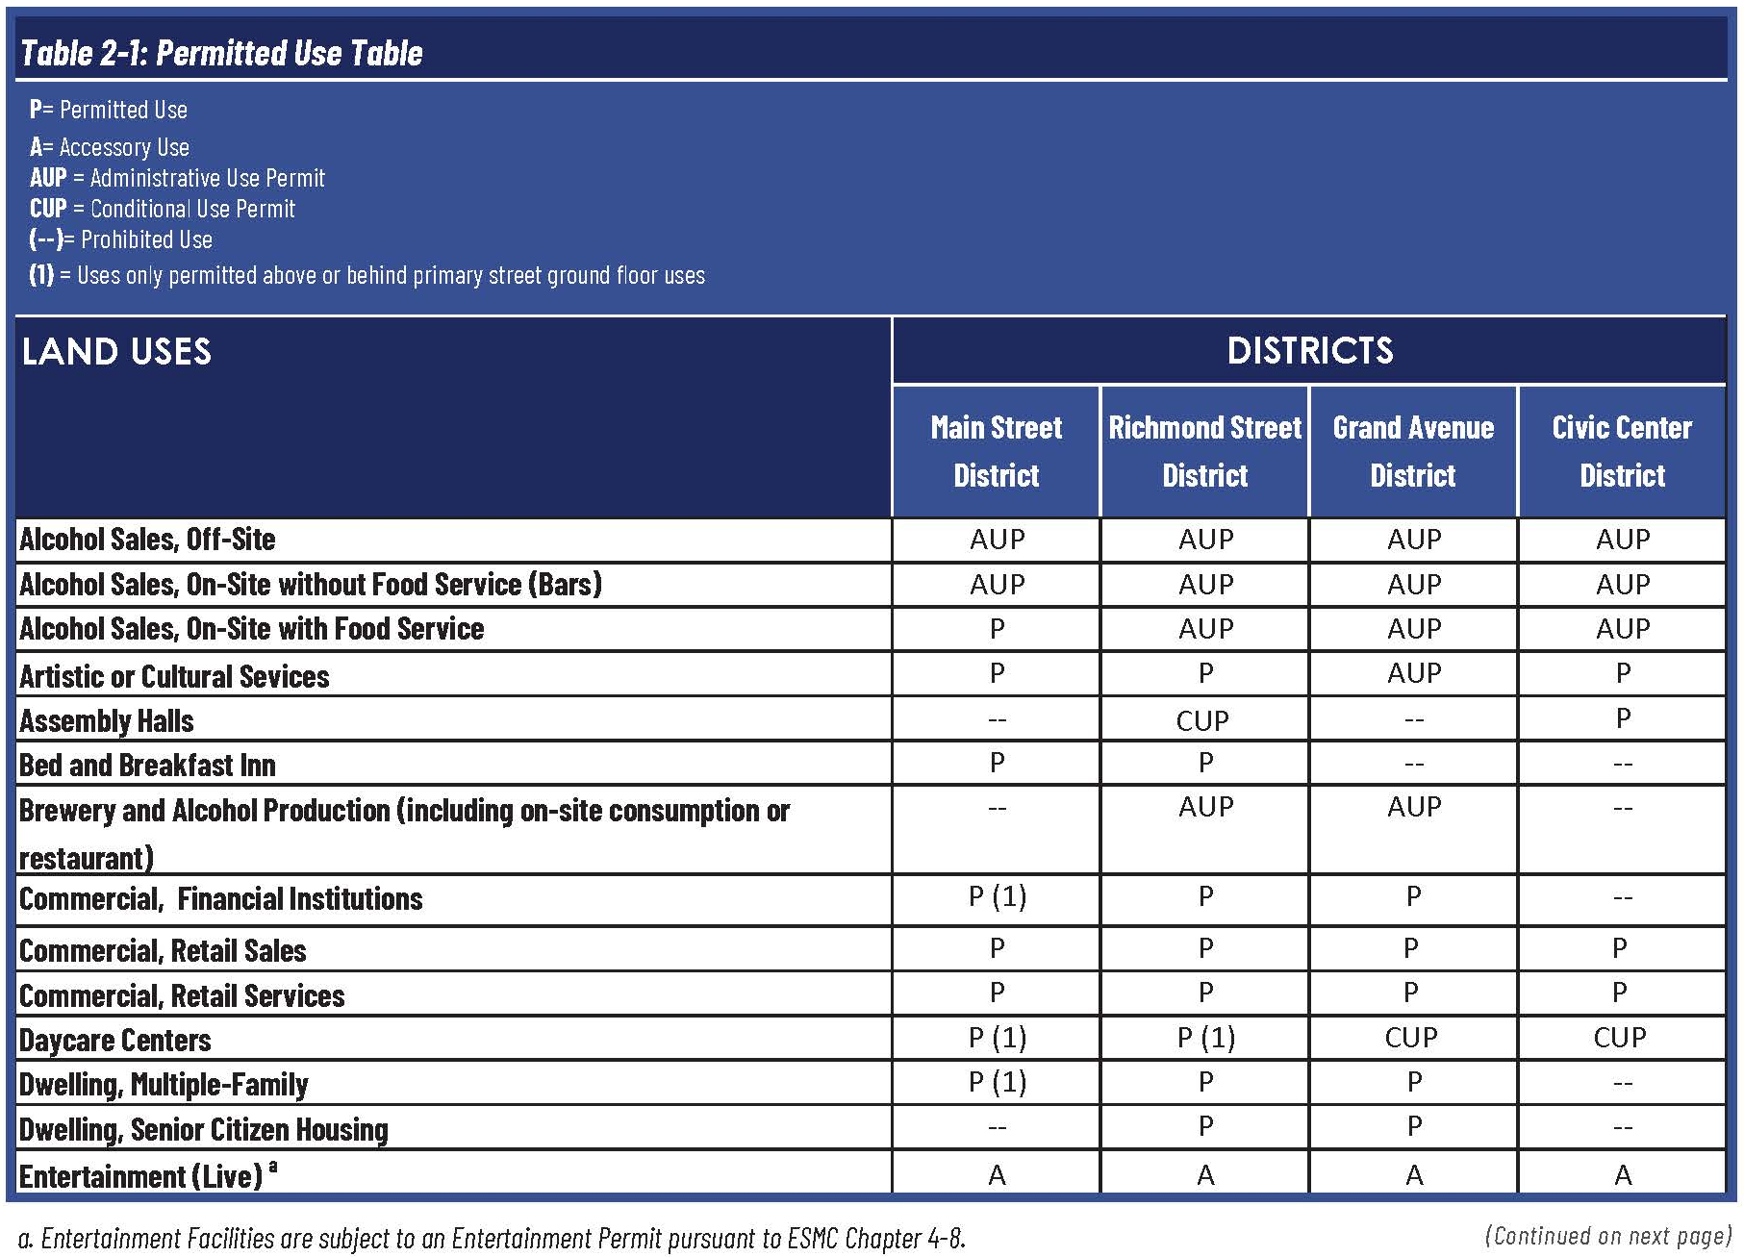
Specific Plan contents
  Private Realm – Land use and development standards
Notes:
In the private realm, regulated permitted uses and development standards

Slide 9
Specific Plan contents
  Private Realm – Land use and development standards
Highlights on permitted uses
Alcohol Service permitted by right at restaurants on Main Street
Breweries permitted with AUP in Richmond Street and Grand Avenue
Daycare centers permitted in Downtown
Recreational, entertainment Facilities and theaters (excluding nightclubs)
Offices on Main Street permitted above or behind primary street frontage
Fitness centers permitted up to 5,000 s.f.
Notes:
In the private realm,

Slide 10
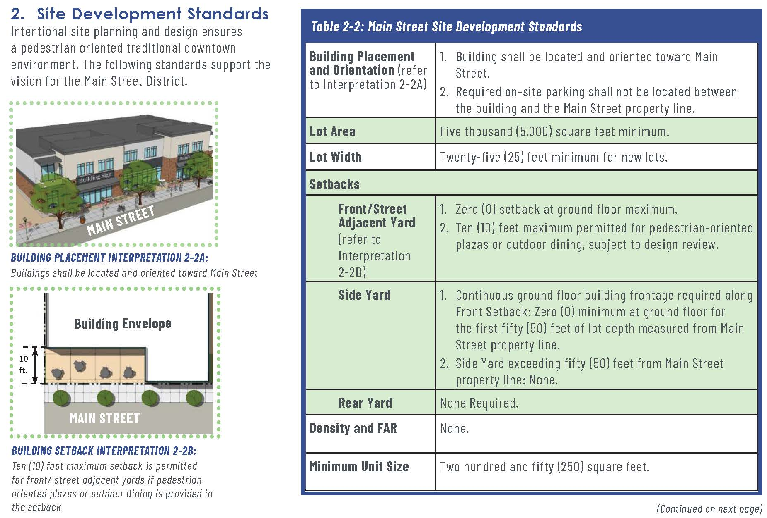
Specific Plan contents
  Private Realm – Land use and development standards
Notes:
Development standards accompanied by exhibits and incorporating certain design guidelines as standards.

Slide 11
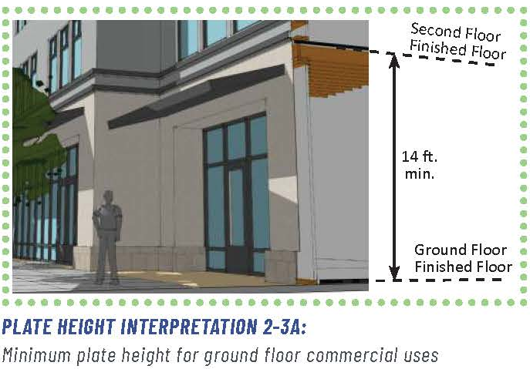
Specific Plan contents
  Private Realm – Land use and development standards
Highlights on development standards (Main/Richmond)
No limit on commercial or residential density
Residential private open space – 50 s.f. per unit
Residential common open space – 25 s.f. per unit
Height limit: 30-45 feet, with 10-foot step back
Height of ground floor: 14 feet
Notes:
The standards on Main and Richmond will be largely the same, except for the standards for minimum glazing (windows) and transparency. On Main Street, which is more retail oriented more glazing. On Richmond which is more office oriented, less glazing and transparency.

Slide 12
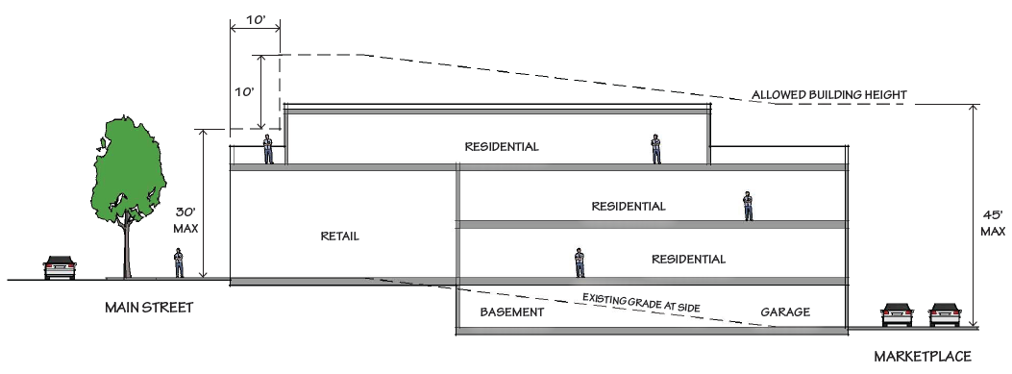
Height Standards
Main Street – Maximum 30’ at street edge & up to 35’ with a 10’ stepback from the front property line
Alley Frontage - Maximum 45’
Office and residential permitted on the ground floor

Slide 13
Specific Plan contents
  Private Realm – Land use and development standards
Highlights on development standards (Grand Avenue)
Larger lot size and lot width requirements
No limit on commercial or residential density
Residential private open space – 50 s.f. per unit
Residential common open space – 100 s.f. per unit
Height limit: 60 feet, with 10-foot step back
Height of ground floor: 14 feet
Landscaping: 10 percent of lot area
Notes:
The standards on Main and Richmond will be largely the same, except for the standards for minimum glazing (windows) and transparency. On Main Street, which is more retail oriented more glazing. On Richmond which is more office oriented, less glazing and transparency.
Grand Avenue is more office and residential oriented. (incorporates larger parcels, including the Chase Bank and Rite Aid sites.
Provisions regarding access (only one access point on Grand and moving parking away from Grand and Main (behind buildings)
Larger lot size presents an opportunity for larger developments including multi-family.

Slide 14
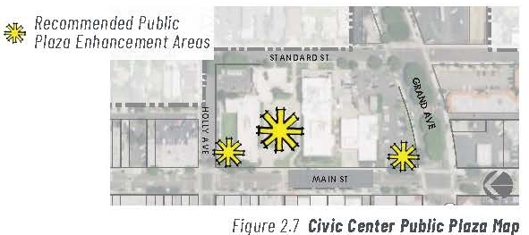
Specific Plan contents
  Private Realm – Land use and development standards
Highlights on development standards (Civic Center)
No requirements for lot area, lot width, setbacks, or density
Building orientation toward Grand and Main
Height: 60 feet
No new access from Main and only one access point on Grand
Landscaping: 25 percent of lot area
Parking: New public parking structure recommended at Grand and Standard
Plaza space design recommendations
Notes:
The standards on Main and Richmond will be largely the same, except for the standards for minimum glazing (windows) and transparency. On Main Street, which is more retail oriented more glazing. On Richmond which is more office oriented, less glazing and transparency.
Grand Avenue is more office and residential oriented. (incorporates larger parcels, including the Chase Bank and Rite Aid sites.
Provisions regarding access (only one access point on Grand and moving parking away from Grand and Main (behind buildings)
Larger lot size presents an opportunity for larger developments including multi-family.
Civic Center
Maximum flexibility for setbacks and density
Recommended parking structure and new plaza space at Grand and Main
Three plazas: multi-use outdoor space (flexible) passive and active space, event space, shaded areas.

Slide 15
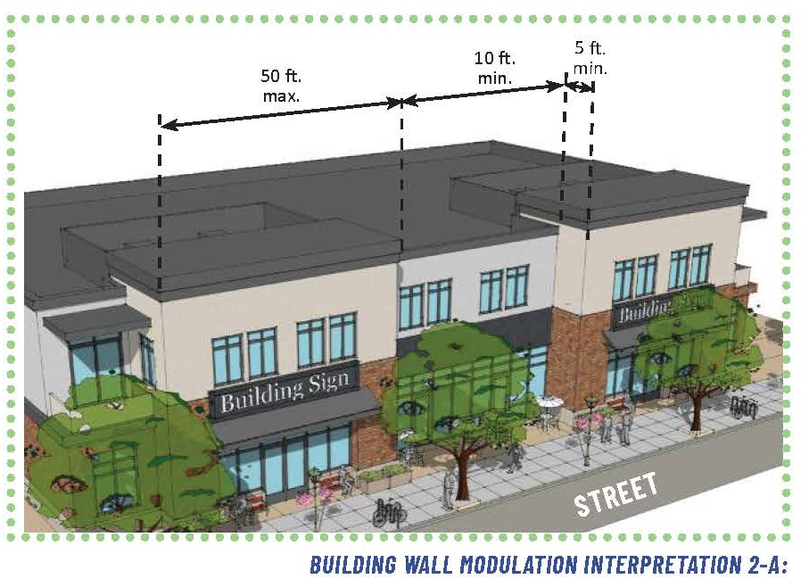
Specific Plan contents
  Private Realm – Design standards and Guidelines
Area wide
Building Wall modulation
Roofline variation
Primary entrance design
Additional window and glazing standards
Historic Resources
Parking:
Plaza

Slide 16
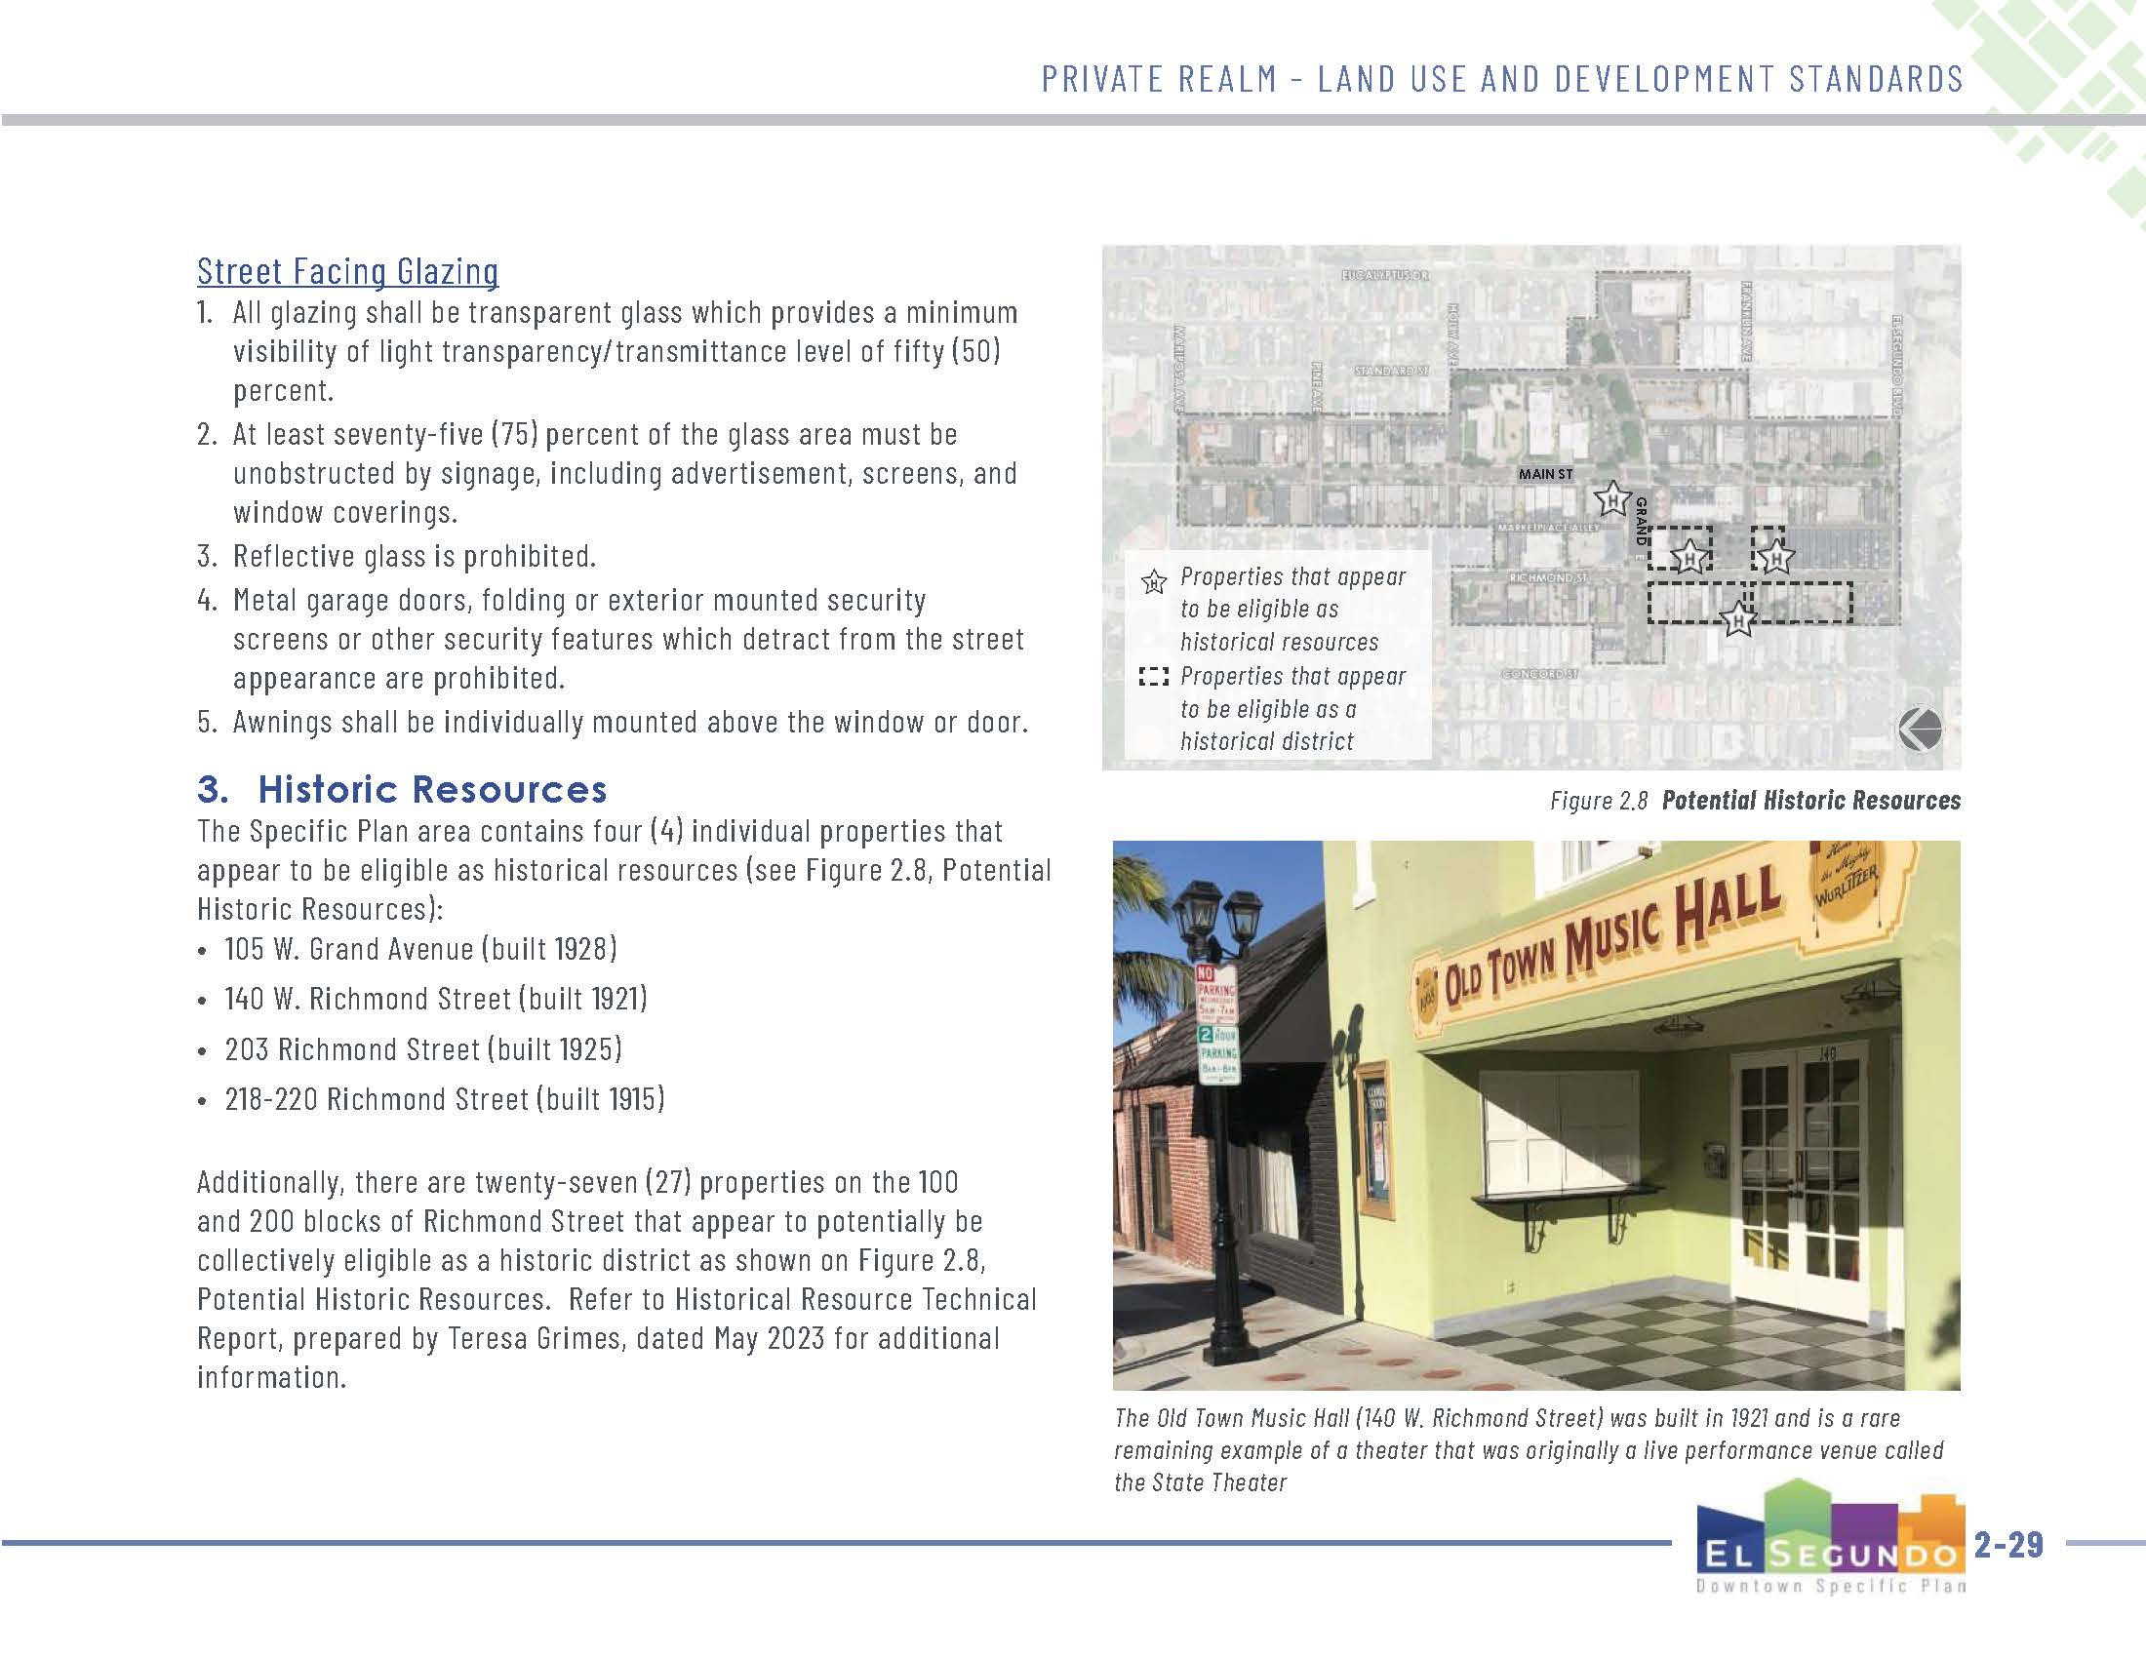
Specific Plan contents
  Private Realm – Design standards and Guidelines
105 W. Grand (1928)
Area wide
Building Wall modulation
Roofline variation
Primary entrance design
Additional window and glazing standards
Historic Resources
Parking:
Plaza
140 Richmond (1921)
218 Richmond (1915)
203 Richmond (1925)

Slide 17
Specific Plan contents
  Private Realm – Design standards and Guidelines
Area wide
Building Wall modulation
Roofline variation
Primary entrance design
Additional window and glazing standards
Historic Resources
Parking
Signs
Outdoor dining
Notes:
Signs
Utilized existing standards primarily
Organized and formatted to be easy to read and understand
Expanded signage for non-street fronting uses (alleys and interior lot lines)
More specifics on A-frame signs.

Slide 18
Specific Plan contents
  Private Realm – Design standards and Guidelines
Parking
Use | Proposed requirement | Current requirement
Retail* | 1 space per 667 s.f. | 1 space per 300 s.f
Office* | 1 space per 500 s.f. | 1 space per 300 s.f.
Restaurants | 1 space per 667 s.f. | 1 space per 300 s.f.)
Outdoor Dining | 0 spaces for 0-500 s.f. | 0 spaces for 0-200 s.f.
Outdoor Dining | 1 space per 300 s.f. for 500+ s.f. | 1 per 75 s.f. for 200+ s.f.
No additional parking for changes in use up to 10,000 s.f.
New required parking table – significant reductions
Parking Structure Design Guidelines
Loading/service area standards
Notes:
Parking:
Keep exemption for changes in use with a limit up to 10,000 s.f. The specific plan will include larger properties with larger developments, which should provide add’l parking
Significant reductions in parking requirements for most uses. These are some of the examples. The intent behind the proposed reduction is two-fold: 1) to encourage/facilitate new development and filling vacancies 2) Adequate parking in the near term, provision of public structures in the long term, and 3) larger developments (along grand would provide parking at a higher rate

Slide 19
Specific Plan contents
  Private Realm – Design standards and Guidelines
Outdoor dining
Barriers
Furniture (tables, chairs, etc.)
Shade structures
Lighting
Pedestrian access
Adjacent business visibility
Notes:
Outdoor dining
Barrier height, material, maintenance/appearance
Furniture material, colors, shape, durability
Umbrellas height, colors, size/shape, material,
Lighting Height, Color, supports, power cords,
Pedestrian access: 6-foot clear passage area adjacent to the curb
Parklets, part of future program:
Staff to come back with program parameters separately.

Slide 20
Specific Plan contents
  3. Public Realm – Multimodal Mobility
Pedestrian Network
Bicycle Circulation
Improved Public Parking
Public Transit
Vehicular Circulation
Parking Strategies
Notes:
Pedestrian: Two-thirds of our survey respondents listed walkability as one of their top priorities
This chapter includes several recommended improvements to provide for pedestrian safety and comfort.
ADA improvements, ped crossing improvements, midblock crosswalk, paseo/alley improvements and WAYFINDING
Bike Wayfinding – consistent with and in addition to the City’s bike Master Plan
Public Transit – resume lunch-time shuttle and expand hours of service to the evening. In the long term working with BCT to increase frequency of service.
Improve bus stops with amenities (bench, shelter, waste bins), and increase the length of the red-curb zone.

Slide 21
Specific Plan contents
  Public Realm – Multimodal Mobility
Vehicular Circulation – Main Street Existing

Slide 22
Specific Plan contents
  Public Realm – Multimodal Mobility
Vehicular Circulation – Main Street Preferred

Slide 23
Specific Plan contents
  Public Realm – Multimodal Mobility
Vehicular Circulation – Main Street Alternative

Slide 24
Specific Plan contents
  Public Realm – Multimodal Mobility
Vehicular Circulation – Grand Avenue Existing
Notes:
Grand (100 feet), between Main and Concord and also east of Main with wider median.
Today it has curb parking, a median and median parking, and two lanes in each direction

Slide 25
Specific Plan contents
  Public Realm – Multimodal Mobility
Vehicular Circulation – Grand Avenue Preferred
Notes:
The preferred alternative would extend the sidewalk, add angled parking at the curb, maintain one lane in each direction and eliminate the median parking.

Slide 26
Specific Plan contents
  Public Realm – Multimodal Mobility
Vehicular Circulation – Grand Avenue Alternative 1
Notes:
There are two alternatives provided:
1) Widen the sidewalks, maintain parallel parking, add dedicated bike lane (buffered), maintain one lane in each direction and widen the median. The alternative promotes pedestrian activity, safer bicycle circulation, beautifying the row, and slowing down traffic in downtown.

Slide 27
Specific Plan contents
  Public Realm – Multimodal Mobility
Vehicular Circulation – Grand Avenue Alternative 2
Notes:
There are two alternatives provided:
1) Widen the sidewalks, maintain parallel parking, add dedicated bike lane (buffered), maintain one lane in each direction and widen the median. The alternative promotes pedestrian activity, safer bicycle circulation, beautifying the row, and slowing down traffic in downtown.
2) The second alternative involves a separated bike path, adding angled parking at the curb and keeping one lane in each direction, median parking is eliminated, and sidewalks remain at same width. (bicycle-focused alternative)

Slide 28
Specific Plan contents
  Public Realm – Multimodal Mobility
Vehicular Circulation – Richmond Street Existing
Notes:
Currently, there is parking on both sides and two travel lanes (narrow sidwalks)

Slide 29
Specific Plan contents
  Public Realm – Multimodal Mobility
Vehicular Circulation – Richmond Street Preferred
Notes:
To improve on the pedestrian and outdoor dining experience, the preferred alternative eliminates the onstreet parking between Franklin and Grand and widening the sidewalk area

Slide 30
Specific Plan contents
  Public Realm – Multimodal Mobility
Vehicular Circulation – Richmond Street Alternative
Notes:
AN alternative that is more ambitious is to completely close off the street to create a Pedestrian Mall concept (permit emergency access)
This includes widening the sidewalks and closing off the street at Grand and Franklin

Slide 31
Specific Plan contents
  Public Realm – Multimodal Mobility
Vehicular Circulation – Other improvements
Intersection Control
Street Closure Placemaking
Alley Enhancements
Parking Strategies
Notes:
Add Protected left turn phases to signaled intersections
Add stop signs and stop bars on stop controlled intersections with side streets/alleys
Main Street – improvements (decorative paving)
Richmond – at a minimum add removable bollards to allow for future temp closures for events
Consider permanent closure
Alleys, public art, tree and landscape enhancement, entry elements, lighting, better screening of trash/recycling receptacles

Slide 32
Specific Plan contents
  Public Realm – Multimodal Mobility
Vehicular Circulation – Other improvements
Intersection Control
Street Closure Placemaking
Alley Enhancements
Parking Strategies
Notes:
Regarding parking, we had review some of this information at your study session in November:

Slide 33
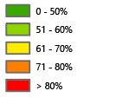
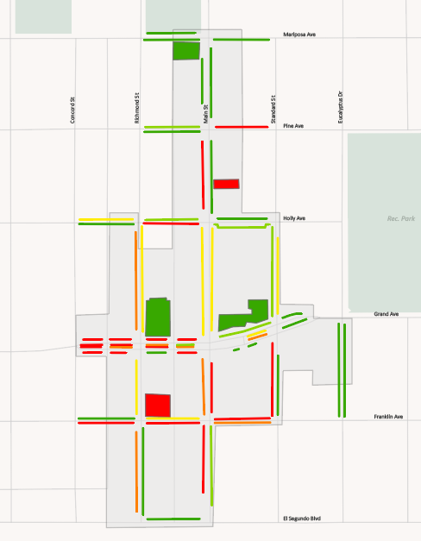
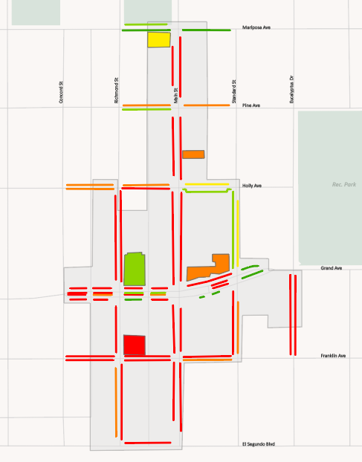
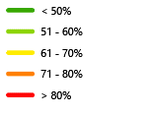
Parking Analysis
OFF-STREET PARKING UTILIZATION
  Highest at the northeast corner of Franklin Avenue & Richmond Street
  Lowest at the northeast corner of Grand Avenue & Richmond Street and southwest corner of Mariposa Avenue & Main Street
  Highest in the southern portion of DSP area (south of Holly Avenue)
Main
Main
Richmond
Richmond
Holly Ave
Holly Ave
Grand Ave
Grand Ave
ON-STREET PARKING UTILIZATION
Franklin
Franklin
Existing weekend utilization
  Existing Weekend Utilization
  Existing Weekday Utilization
Notes:
Our parking analysis showed that there is generally adequate parking today and in the short term to accommodate parking demand. Generally, the intent of the Specific Plan is to require parking onsite for future large development projects, provide

Slide 34
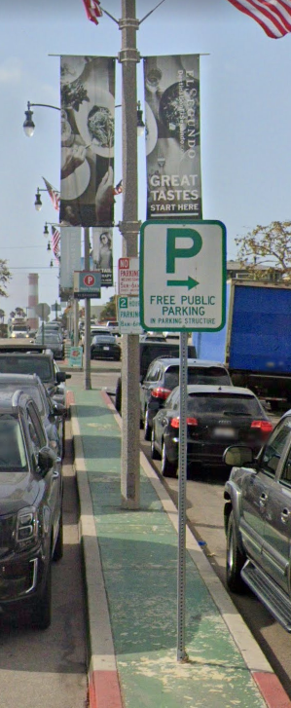

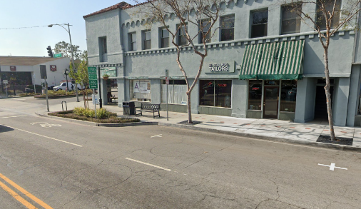
Parking Management Strategies
ON-STREET PARKING IMPROVEMENTS
OFF-STREET PARKING IMPROVEMENTS
Re-stripe parallel parking spaces with delineation lines
Expand angled parking
Implement a shared-parking program for local businesses
Develop informational programs for drivers – such as increased parking wayfinding signage or online maps parking
Notes:
Promote shared-parking and wayfinding for off-street parking
Make on-street parking improvements including delineating parking spaces and expand use of angled parking. We covered some of the areas where angled parking could be provided in the various street improvement concepts a bit earlier.
AND
Public parking structures

Slide 35
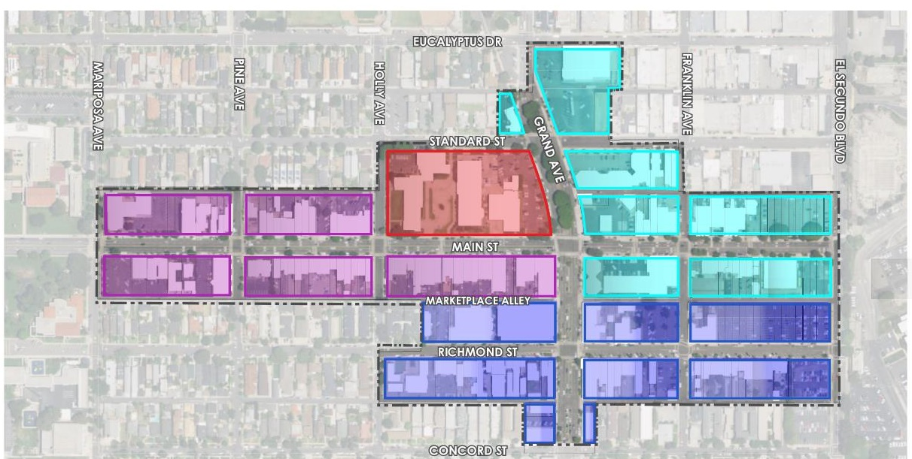

Potential Parking Structures
POTENTIAL ADDITIONAL PARKING STRUCTURES
Potential new parking structures at:
Franklin Avenue & Richmond Street
City Hall

Slide 36
Specific Plan contents
  4. Public Realm – Placemaking and Beautification
Gateway and Wayfinding Signage
Streetscape Design and Pedestrian Amenities
Public Art
Landscaping

Slide 37
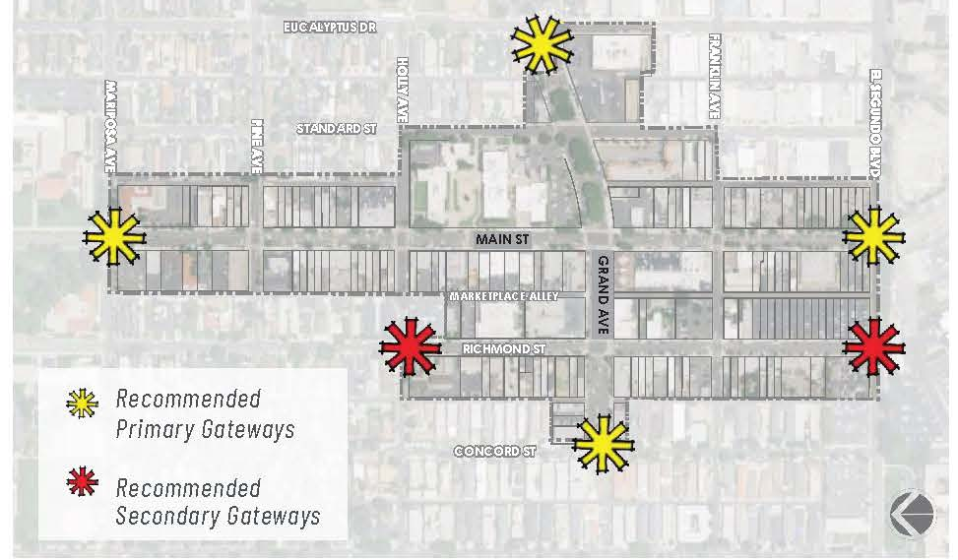
Specific Plan contents
  Public Realm – Placemaking and Beautification
Notes:
This is a map of the potential gateway sign locations
These are examples of vehicular and pedestrian wayfinding signs.

Slide 38
Specific Plan contents
  Public Realm – Placemaking and Beautification
Gateway and Wayfinding Signage
Streetscape Design and Pedestrian Amenities
Public Art
Landscaping
Notes:
Streetscape and pedestrian amenities would include furniture, waste receptables, tree grates, bike racks, bus shelters, lighting, decorative paving, etc.

Slide 39
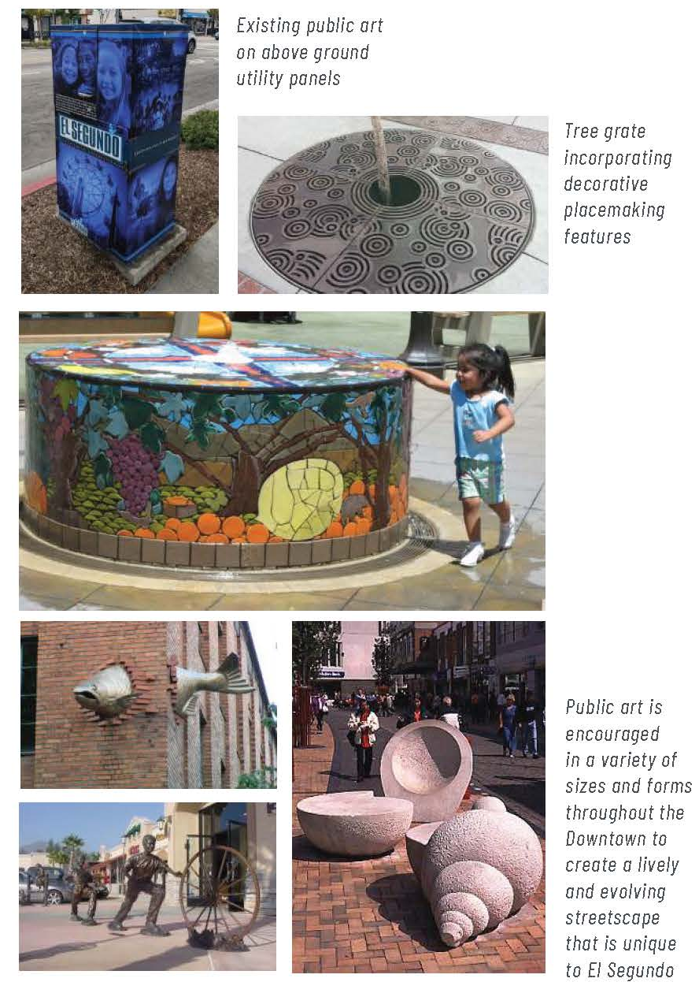
Specific Plan contents
  Public Realm – Placemaking and Beautification
Gateway and Wayfinding Signage
Streetscape Design and Pedestrian Amenities
Public Art
Landscaping
Notes:
Streetscape and pedestrian amenities would include furniture, waste receptables, tree grates, bike racks, bus shelters, lighting, decorative paving, etc.
These are some examples of the types of art and landscaping that could be added in public spaces and along streets.

Slide 40
Specific Plan contents
  5. Infrastructure and Public Facilities
Infrastructure
Water Supply
Wastewater Services
Stormwater Management
Dry Utilities

Slide 41
Specific Plan contents
  Infrastructure and Public Facilities
Public Facilities
Police and Fire
Schools and Parks
Solid Waste Collection
Library

Slide 42
Specific Plan contents
  6. Implementation
Market, Real Estate, and Financial Analysis
Implementation Plan
  Programs, studies, and Initiatives
  Improvement Projects
Funding Mechanisms
  City Resources
  Grants
  Developers
  District-Based Tools

Slide 43
Specific Plan contents
  7. Administration
Specific Plan Amendments
Administration
  Interpretation
  Nonconformities
  Administrative Determinations
  Adjustments
Design Review Process
  Levels of Review
  Process
Environmental Review
Notes:
The administration chapter essentially describes how the Specific Plan will be used.
How its provisions will be interpreted
How nonconforming uses or buildings will be handled
How exceptions ( or adjustments) will be reviewed
When design review will be conducted, which will involve similar to today three levels of review, staff, director, and Planning Commission for larger projects. The director will have some more authority to approve design review applications.
Environmental. Staff is working on a Program Level EIR, which will cover the analysis in some areas and reduce the needs for full analysis of each individual development project that comes through.

Slide 44
Next Steps
  Public comment on draft Downtown Specific Plan
  Revised draft Downtown Specific Plan
  Draft Environmental Impact Report (EIR)
  Final Environmental Impact Report (EIR)
  Public hearings

Slide 45
Questions / Discussion

Slide 46
Extra slides

Slide 47
Overview of Market Demand Projections through 2040
LAND USE DEMAND IN DOWNTOWN EL SEGUNDO
Land Uses | Proposed Project
Retail and Restaurant | 130,000 square feet
Office | 200,000 square feet
Medical Office | 24,000 square feet
Residential Units | 300 dwelling units

Slide 48
Specific Plan contents
  Private Realm – Land use and development standards
Downtown Specific Plan District Map
Notes:
In the private realm,

Slide 49
Permitted uses

Slide 50
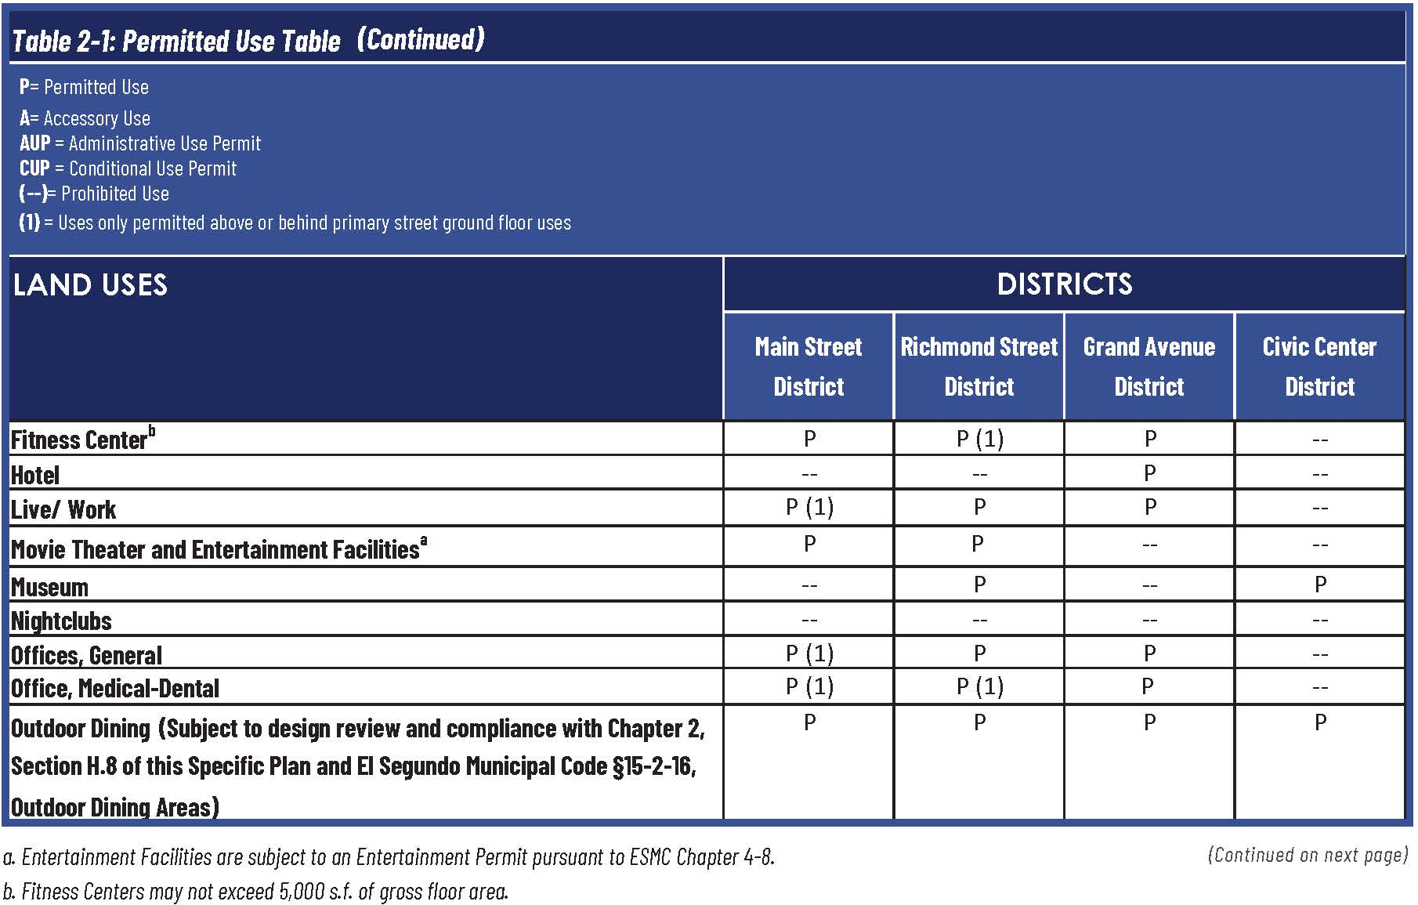
Permitted uses

Slide 51
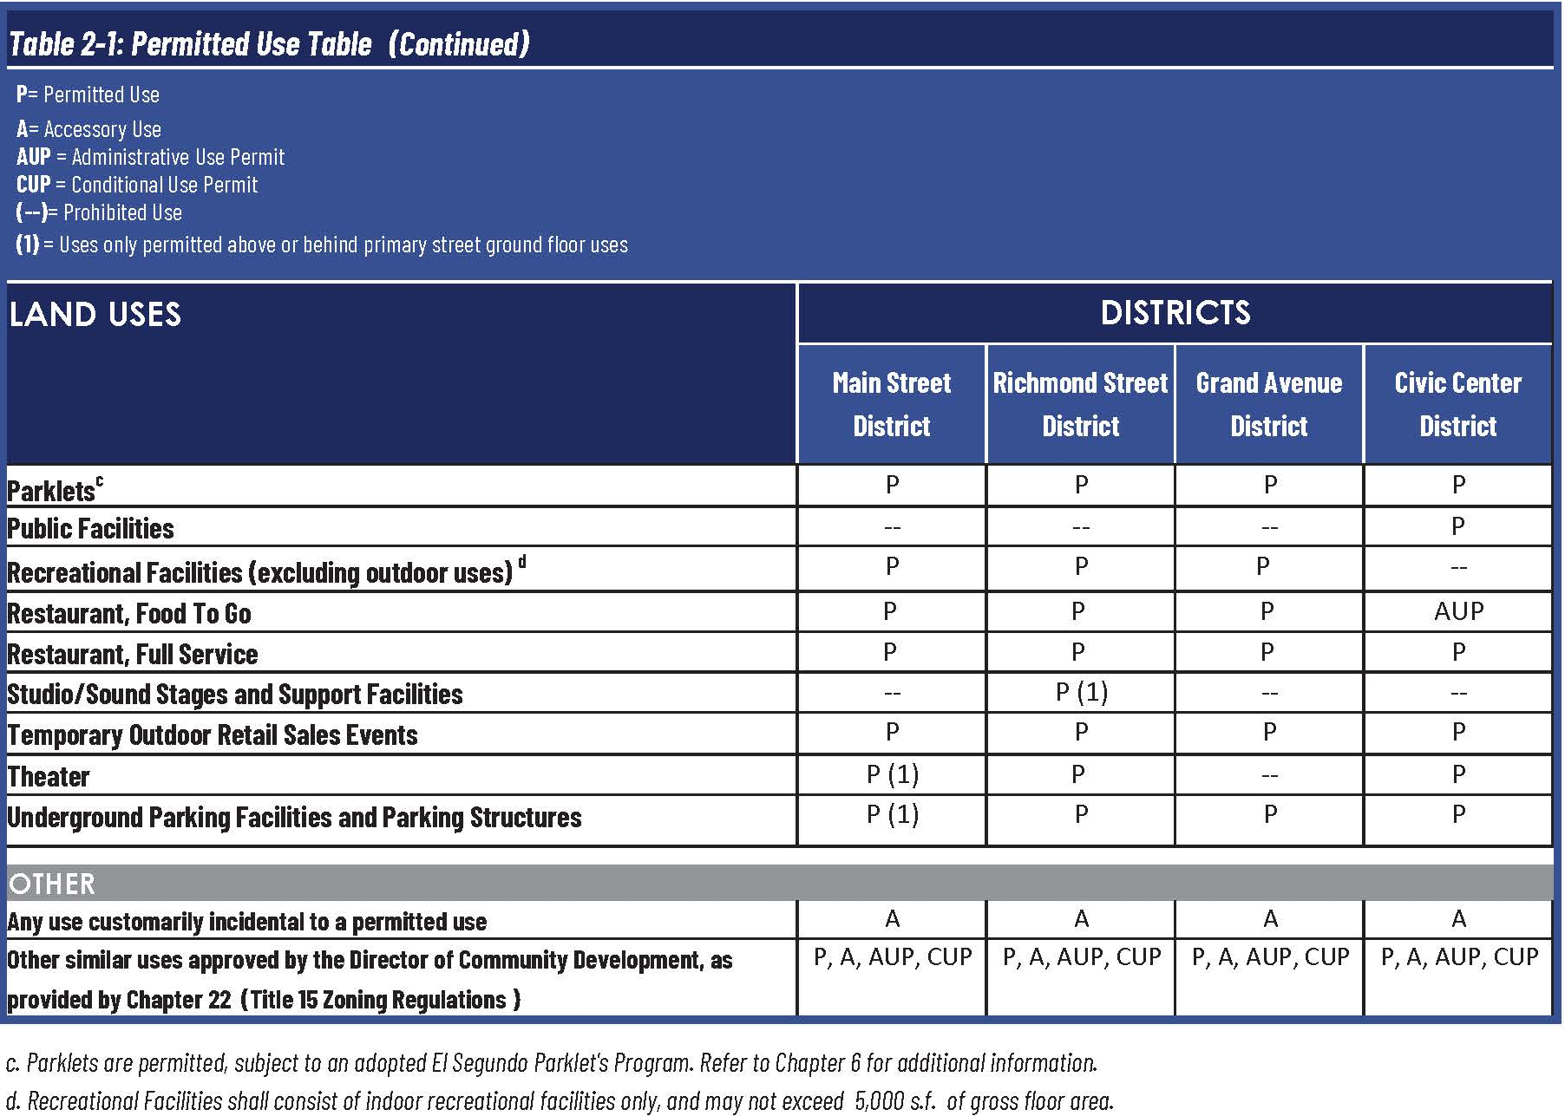
Permitted uses

